Slide 1

Understanding Customer Feedback with Machine Learning By: Kai Wilson

Slide 2

The Problem
Completed as apart of work for LeadX
Analysis of better business company review and Keywords
What are the most common keywords and key phrases from Carvana’s complaints and keywords.
How has the sentiment changed over time.

Slide 3

What is BBB?
They are a Non-profit organization that provides information about business and charities to help consumers make informed decisions.

Slide 4
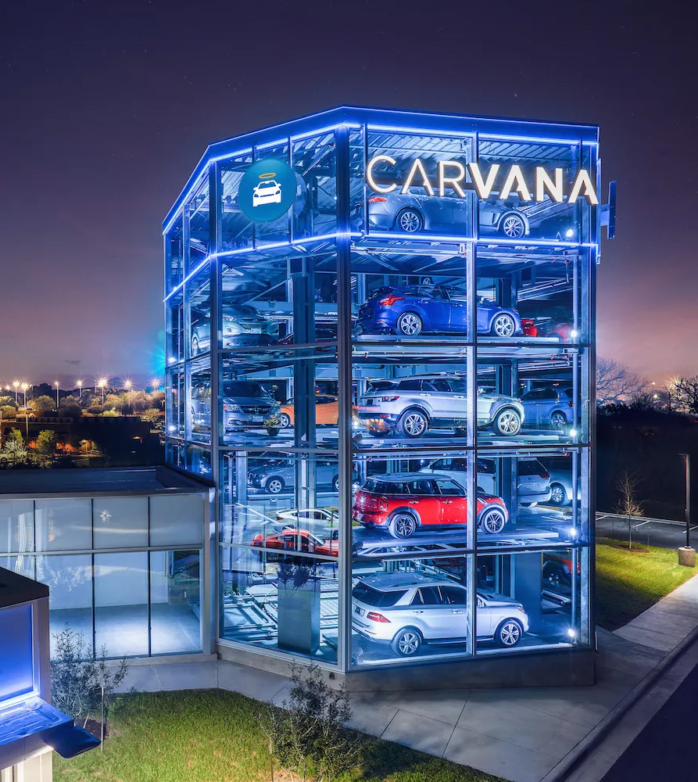
Carvana
An online-only used care retailer.
Years in Business: 12
Business Started: 6/22/2015

Slide 5
AND they have a large amount of data to analyze

Slide 6
But analyzing the large amount of data it would be difficult to grasp the overall sentiment and most used keywords/phrase

Slide 7
Therefore I used a keyword/phrase algorithm and trained a sentiment analysis model to understand the reviews and complaints

Slide 8
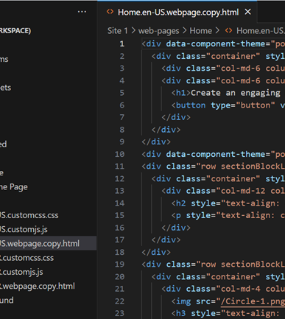
Tools used
Python to gather/clean/analyze the data
Yelp review data stored in a JSON file
Natural Language Processing
Py Shiny Dashboard to visualize the results

Slide 9
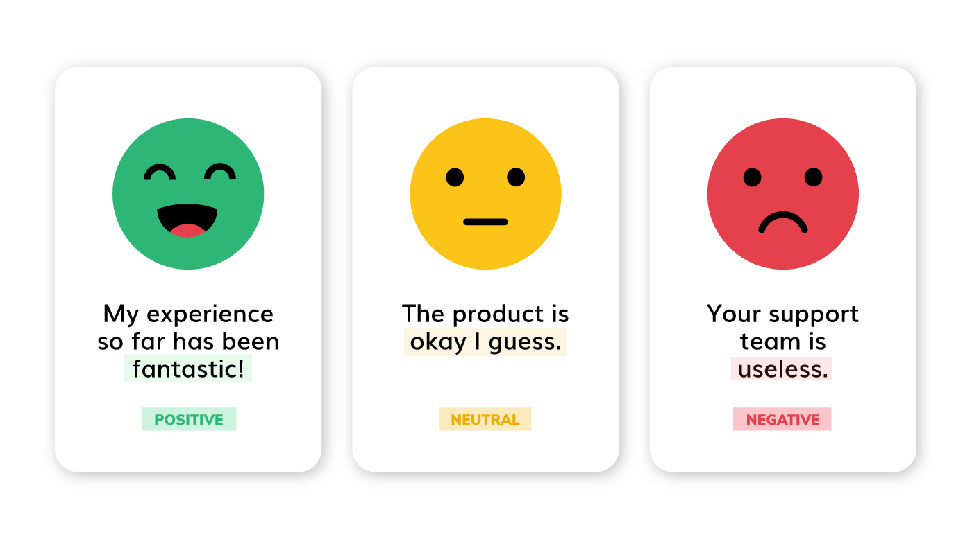
What is Sentiment Analysis
The process of computationally identifying and categorizing opinions expressed in a piece of text, especially to determine whether the writer's attitude towards a particular topic, product, etc. is positive, negative, or neutral.

Slide 10
Example of Reviews
To train the model I used 42,388 reviews from a yelp JSON file and a few reviews from the BBB site itself
4-5 stars were considered positive sentiment
3 stars were neutral sentiment
1-2 stars were negative sentiment
I was delivered a car with broken air bags that took 2 weeks to fix. I extended the 7 day to the *** to give the car I picked a chance to access. Do to their lack of communication am not allowed to swap for a different one. I am looking for a lawyer to attack this 1.61 rated car seller. Please advise if we can take down this corrupt business.
I give carvana a big fat ZERO they are the worst place to try to get a car from, they take your down payment before you are approved, then they keep asking for different proofs which you have already provided to them, then they refuse to give you the vehicle and a refund of the money they took again they do this before you even get approved its bad business. DO NOT DO BUSINESS WITH CARVANA THEY ARE THIEFS! They give you the run around about giving your money back also sont give you a vehicle that makes them THIEVES.AGAIN DO NOT DO BUSINESS WITH CARVANA THEY WILL RIP YOU OFF AND KEEP TELLING YOU YOUR REFUND HAS BEEN INITIATED WHICH IS A LIE ITS BEEN OVER 3 THREE WEEKS AND I HAVEN'T RECEIVED MY REFUN. AWFUL COMPANY I don't believe those 5 star reviews I'm certain they're not real customer reviews. There's no way they have that many or any honestly the crappy way they treat you after they steal your money and refuse to return it. If I could have given them a big fat no stars I would have unfortunately you have to give a star rating that's why it's 1 star there is no lesser option there is nowhere on carvanas website to leave a review

Slide 11
Challenges
Training the sentiment analysis model
Data set of 13,000 reviews was too small and struggled with determining neutral responses.
When I increased the 42,388 reviews it took about 3 hours to complete.
Web scraping
Developing an algorithm to click buttons on the webpage
Handling rate limiting

Slide 12
The Dashboard

Slide 13

The Public perception of a business doesn’t make sense in light of customer feedback

Slide 14

THANK YOU
Questions?

